Slide 1
Survivor Searching in a Dynamically Changing Flood Zone by Multiple Unmanned Aerial Vehicles
DARS-SWARM 2021
Paper ID: 26
Koki Asami¹, Yang Bai², Mikhail Svinin³
¹Kyoto University, Kyoto. Email: asami.koki.54v@st.kyoto-u.ac.jp
²Ritsumeikan University, Shiga. Email: yangbai@fc.ritsumei.ac.jp
³Ritsumeikan University, Shiga. Email: svinin@fc.ritsumei.ac.jp
Notes:
Hello, I’m Koki Asami from Graduate school of Kyoto University. Today, I am going to present, Survivor Searching in a Dynamically Changing Flood Zone by Multiple Unmanned Aerial Vehicles.

Slide 2
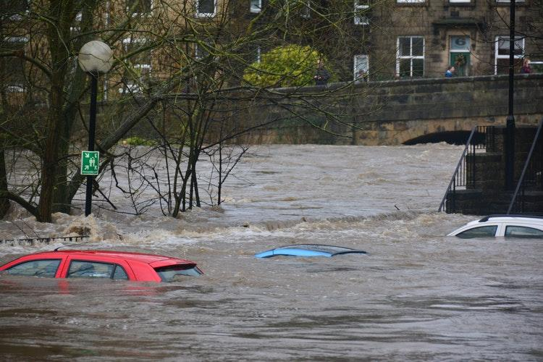
Background
Flood
  Serious disaster
  Dynamic environment
  Hard to monitor by humans
  No research applied multi-agent control
Disaster robotics
  Unmanned aerial vehicles (UAVs)
  Access to dangerous area
Multi-agent system
  Efficient monitoring
Monitoring system for dynamically changing flood by multiple UAVs
https://www.preventionweb.net/news/view/64249
Notes:
This research focus on the flood, which is one of the most serious disaster in the world and there no research applied multi-agent control for the flood.
The scenario considered in the research assuming that the area of the flood is dynamically changing.
The type of robot used in the research is UAVs. Because UAVs have following advantages:
One is UAVs have mobility to access to flood area, whereas mobile ground typed robots are hard to access.
Another is UAVs have high ability of remote sensing such as streaming the video in good quality or receiving the information about the global coordinate from GPS.
This research adapts multi-agent system, because it is more efficient to use multiple agents for the allocation of UAVs.
Also, compared to single-agent system, multi-agent system has higher robustness, stronger adaptivity, and more flexible scalability.

Slide 3
Problem statement
Flood monitoring for survivor searching
  Assuming multiple groups of survivors
  Their positions are time-varying and cannot be accurately measured.
Assign goals to UAVs to achieve optional distribution
(Goal assignment)
Drive UAVs to the assigned goals
(Goal tracking)

Slide 4
Problem statement
Optimal deployment of UAVs to multiple USVs
  UAVs are required to be distributed among the flood area, while concentrate more on the places where survivors may exist.
Reject uncertainties (external forces)
  External forces like strong wind may affect the performance of coverage.
Wind

Slide 5
Control strategy
The aforementioned requirements formulate a coverage problem:
  Can be addressed by Centroidal Voronoi Tessellation (CVT)
Related works to the coverage problem:
  Lee (2015) and Miah (2017) , they did NOT consider system uncertainty.
  Chevet (2019), Li (2020), Xiao (2020) , they considered uncertainty, but did NOT prove stability.
Novelty:
  Address uncertainty & stability in a coverage problem.
  Application to flood monitoring.

Slide 6
Control strategy
Centroidal Voronoi Tessellation(CVT) :
  Optimally partition an area into cells, and each cell contains one agent.
  Agents will stay in the cells to avoid collision.
  Density function: Marks the importance of each point.
Agents
Density function
Cell

Slide 7
Control strategy
Optimal deployment of UAVs to multiple USVs:
  Coverage configuration:
    CVT based goal assignment
  Possible location of survivors:
    Indicated by density function, agents tend to get close to the area with high density.
Positions of UAVs
Density function 1
Density function 2

Slide 8
Control strategy
Controller to deal with uncertainties:
  Error between goal & actual positions due to uncertainties.
  Adaptive controller: Function Approximation Technique-based immersion and invariance (FATII) controller for goal tracking in the presence of uncertainties. (stability is established)
Goal positions of UAVs
Actual positions of UAVs
Density function 1
Density function 2

Slide 9
FATII
Advantages of the proposed FATII controller
  It is model-free and thus, is applicable to a wide range of systems (same controller for heterogeneous agents)
  Different from many model-free methods, the stability of the proposed method is well established
  Adaptive to large uncertainties
  Compared with other robust adaptive approaches, FATII method converges both states and uncertainty estimation, and thus has better performance

Slide 10
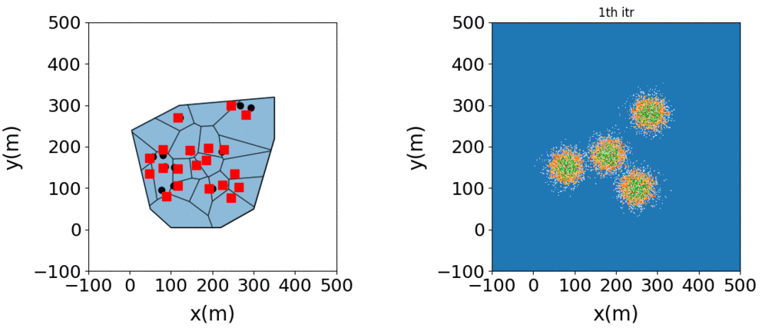
Flood monitoring by multiple UAVs
Desired positions
Current positions
A time-varying multi-modal density function

Slide 11
Conclusions
Provide a robotics-based solution for monitoring a flood disaster area.
Control strategy
  Utilize multi-agent system (UAVs) in the flood monitoring.
  Apply CVT to allocate UAVs in order to optimize coverage efficiency.
  Design FATII controller to reject external disturbance to the control system.

Slide 12
Thank You!

Slide 13
FATII
Robust adaptive tracking controller design
  A function approximation technique based immersion and invariance (FATII) approach
Actual system
Ideal system
Uncertainty
Given a system $\dot{x}=f+Gu+ξ$
  $x$ and $u$ are output and input
  $f$ and $G$ uncertain
  $ξ$ denotes external disturbance
Introduce a virtual input $u^{∗}$ where $u=G^{∗}u^{∗}$
  Yielding $\dot{x}=f+GG^{∗}u^{∗}+ξ≡u^{∗}+d$
  Uncertainty$d=f+(GG^{∗}−I)u^{∗}+ξ$

Slide 14
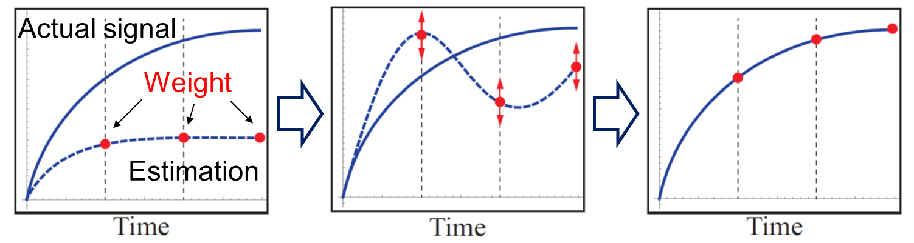
FATII
Robust adaptive tracking controller design
  A function approximation technique based immersion and invariance (FATII) approach
Actual system
Ideal system
Uncertainty
Basis function weighted by unknown parameter
Uncertainty estimation $d=\sum_{i=0}^{N}{d_{i}ψ_{i}}+ε$
Thus one obtains $\dot{x}=u^{∗}+\sum_{i=0}^{N}{d_{i}ψ_{i}}+ε$
  Linear system with parametric error $d_{i}$
  Time-varying uncertainty term (bounded) $ε$

Slide 15
FATII
Robust adaptive tracking controller design
  A function approximation technique based immersion and invariance (FATII) approach
Actual system
Ideal system
Uncertainty
Basis function weighted by unknown parameter
Identify parameters and design the controller
FATII controller:
Simplified version:

Slide 16
FATII
Advantages of the proposed FATII controller
  It is model-free and thus, is applicable to a wide range of systems (same controller for heterogeneous agents)
  Different from many model-free methods, the stability of the proposed method is well established
  Adaptive to large uncertainties
  Compared with other robust adaptive approaches, FATII method converges both states and uncertainty estimation, and thus has better performance

